Slide 1




HUDSON HORNET TEAM
Cloud-Native AI-Powered Food Ordering Platform

Slide 2


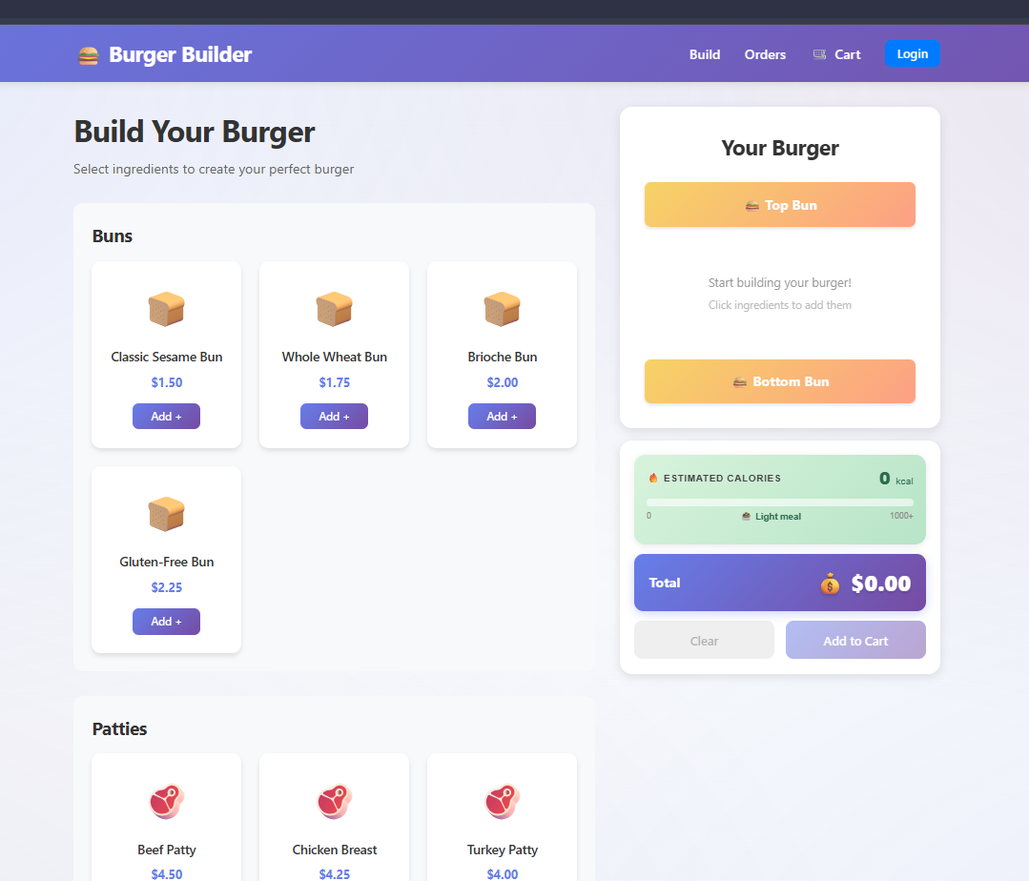
BURGER BUILDER
Home
Overview
Features
DevOps
PROJECT
OVERVIEW
Burger Builder is a cloud-based web app where users can build and order their perfect custom burger. It features a React frontend, and a Java backend — all running on Azure with automated deployment pipelines and built-in security monitoring.

Slide 3

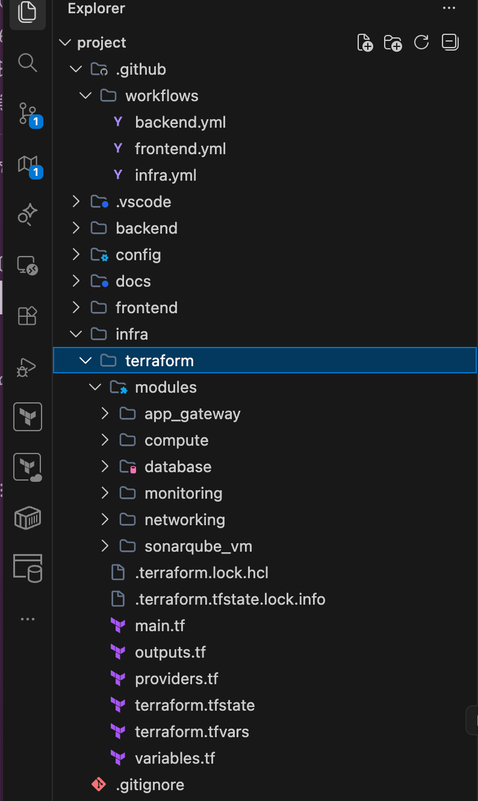
Infrastructure Automation with Terraform
We built the entire cloud infrastructure using Terraform — the industry-standard Infrastructure as Code tool. Instead of manually creating resources in the Azure portal, everything is defined as code.
To make the project clean, scalable, and easy to maintain, I organized the Terraform code into modular structure. Inside the terraform/modules folder you can see separate modules for each

Slide 4


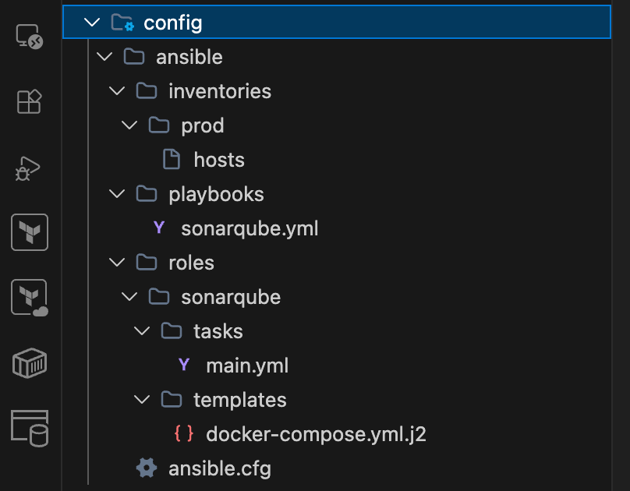
SONARQUBE
& ANSIBLE AUTOMATION
Using Ansible, we automatically deploy and configure SonarQube — our code quality analysis tool — on the virtual machine. This includes installing Docker, pulling the latest SonarQube image, configuring the environment, and starting the service through a Docker Compose template.

Slide 5

BURGER BUILDER
СI & CD PIPELINES

Slide 6
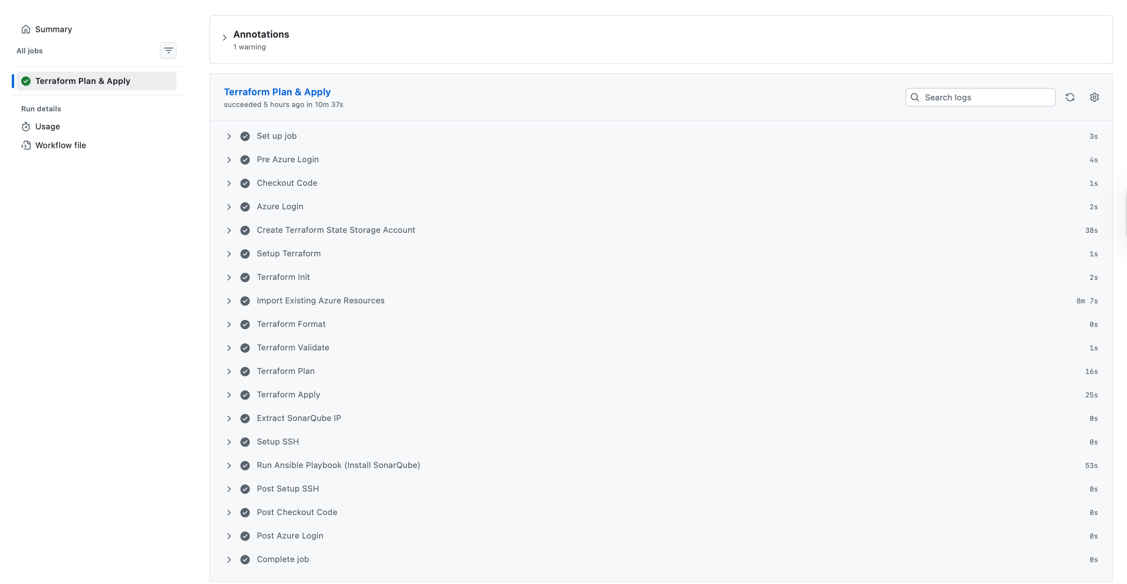

Slide 7
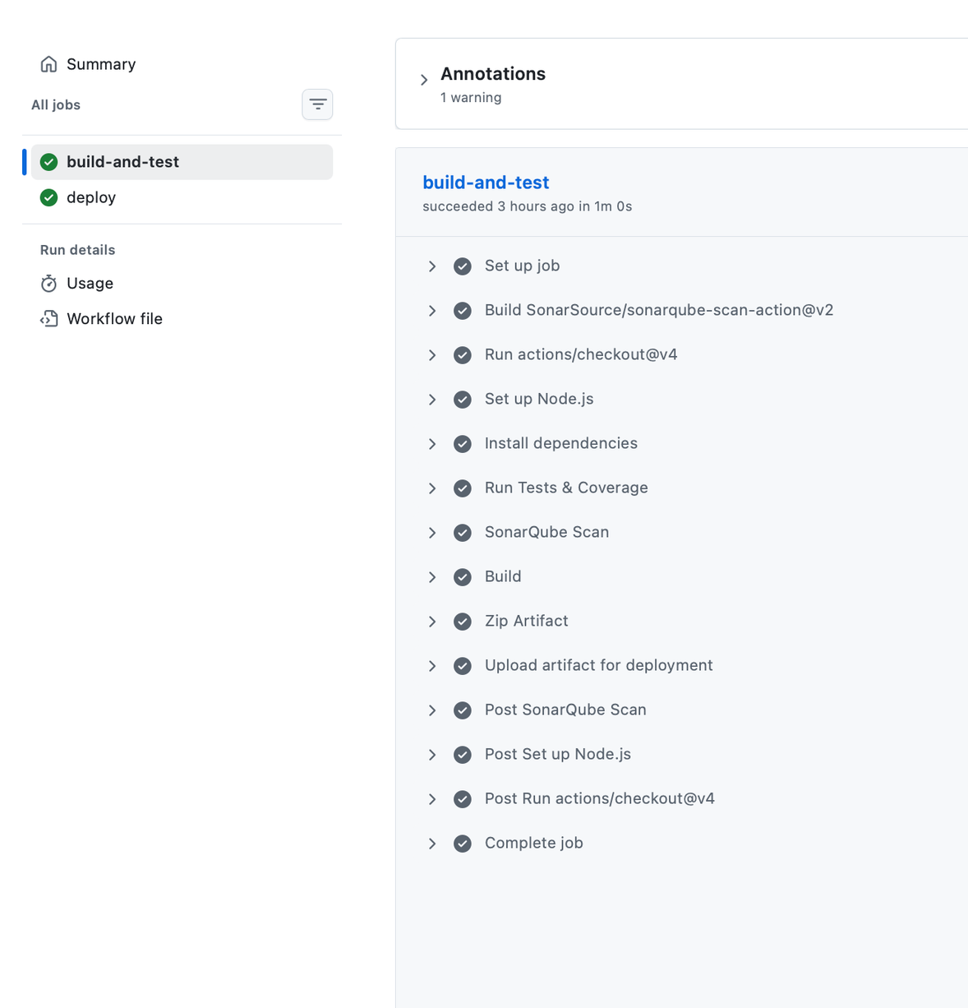
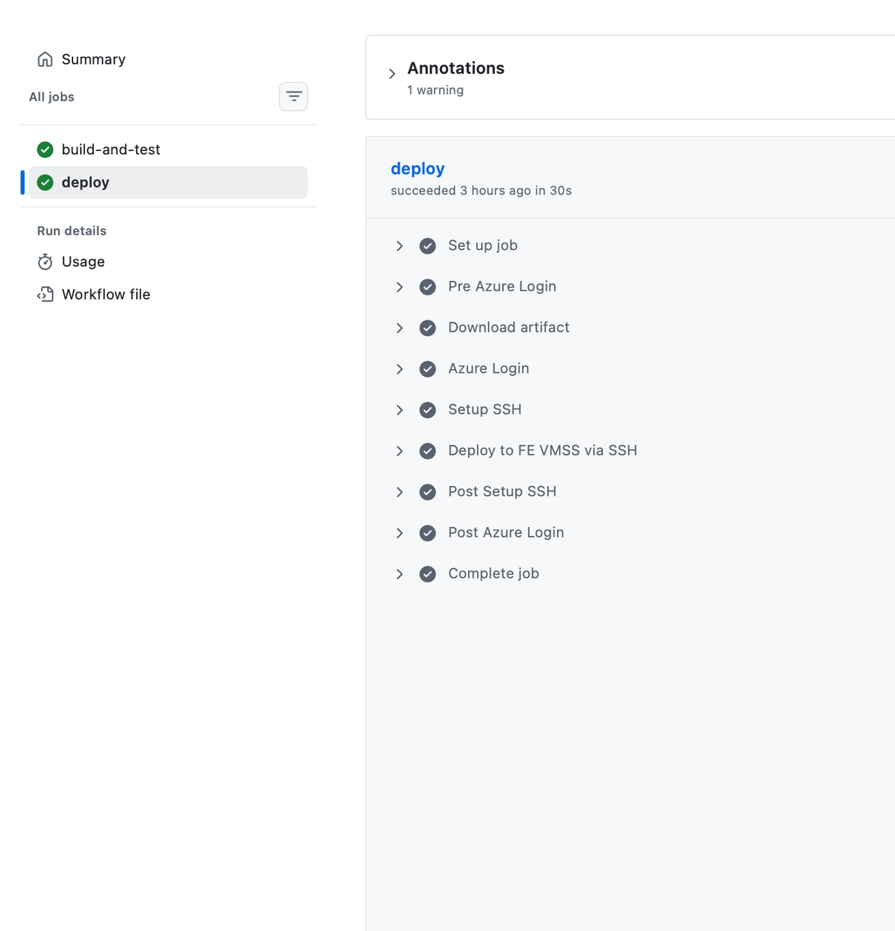

Slide 8


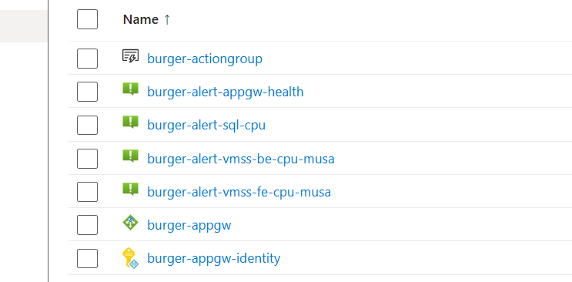

Burger Builder
Home
Monitor
Metrics
Alerts
AZURE MONITOR
& LOG ANALYTICS
Real-time metrics powering our observability stack: Application performance tracking (CPU, memory, network utilization), And in our project we have 4 alerts:
App Gateway - UnhealthyHostCount > 0
Frontend VMSS - CPU > 70%
Backend VMSS - CPU > 70%
SQL Database - CPU > 80%
)

Slide 9
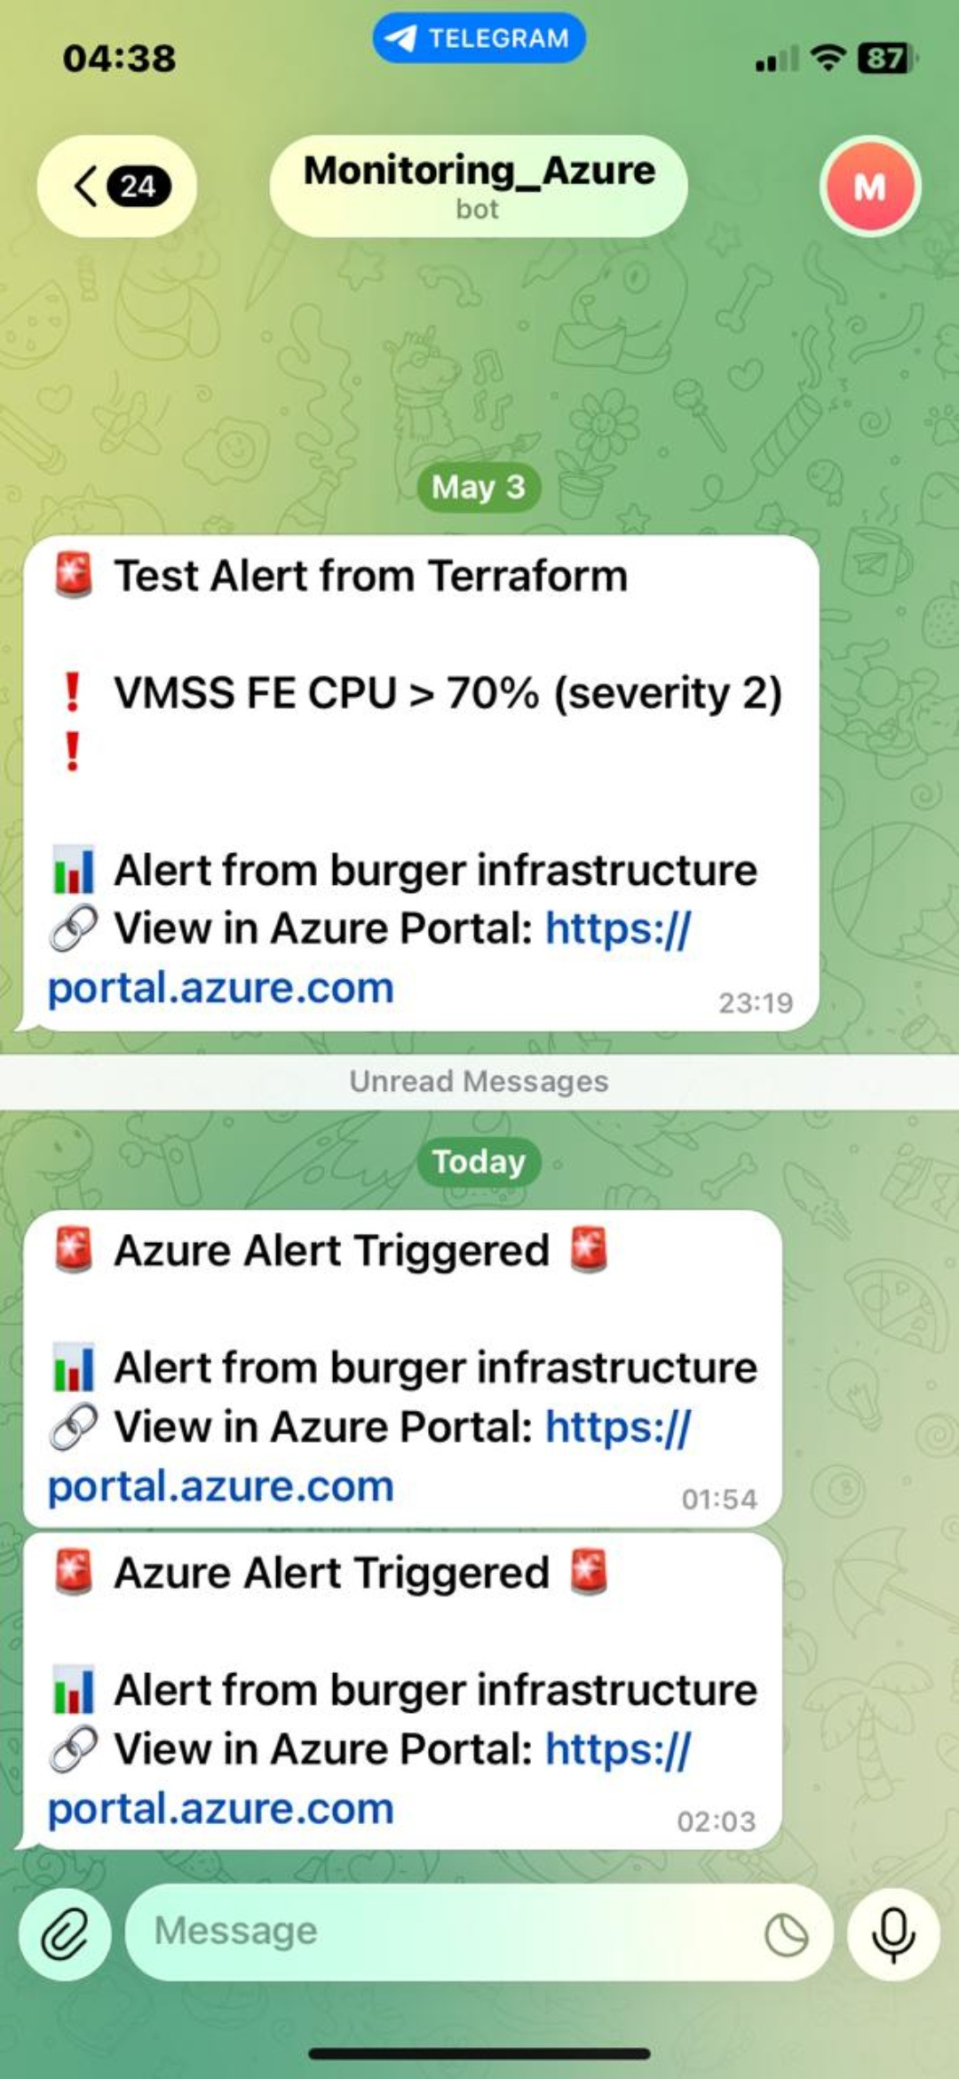
Burger Builder
Home
Monitor
Metrics
Alerts
TELEGRAM BOT FOR ALERTS
(OUR NEW FEATURE)
ALERT NOTIFICATIONS ARE AUTOMATICALLY SENT TO OUR TELEGRAM BOT FOR FAST REACTION AND TO OUR TEAM GMAIL FOR MORE DETAILED REPORTS. THIS WAY WE ALWAYS STAY IN CONTROL OF THE APPLICATION’S HEALTH."

Slide 10

Burger Builder
SCALABILITY
We start with 1 VM per tier and designed the architecture for horizontal scaling using Azure Virtual Machine Scale Sets (VMSS).
Autoscaling Rules
Scale (UP)
Metric: CPU Percentage
Condition: Average CPU > 60% over 10 minutes
Action: Add 1 instance
Maximum: 3 instances
Scale (DOWN)
Metric: CPU Percentage
Condition: Average CPU < 25% over 10 minutes
Action: Remove 1 instance

Slide 11
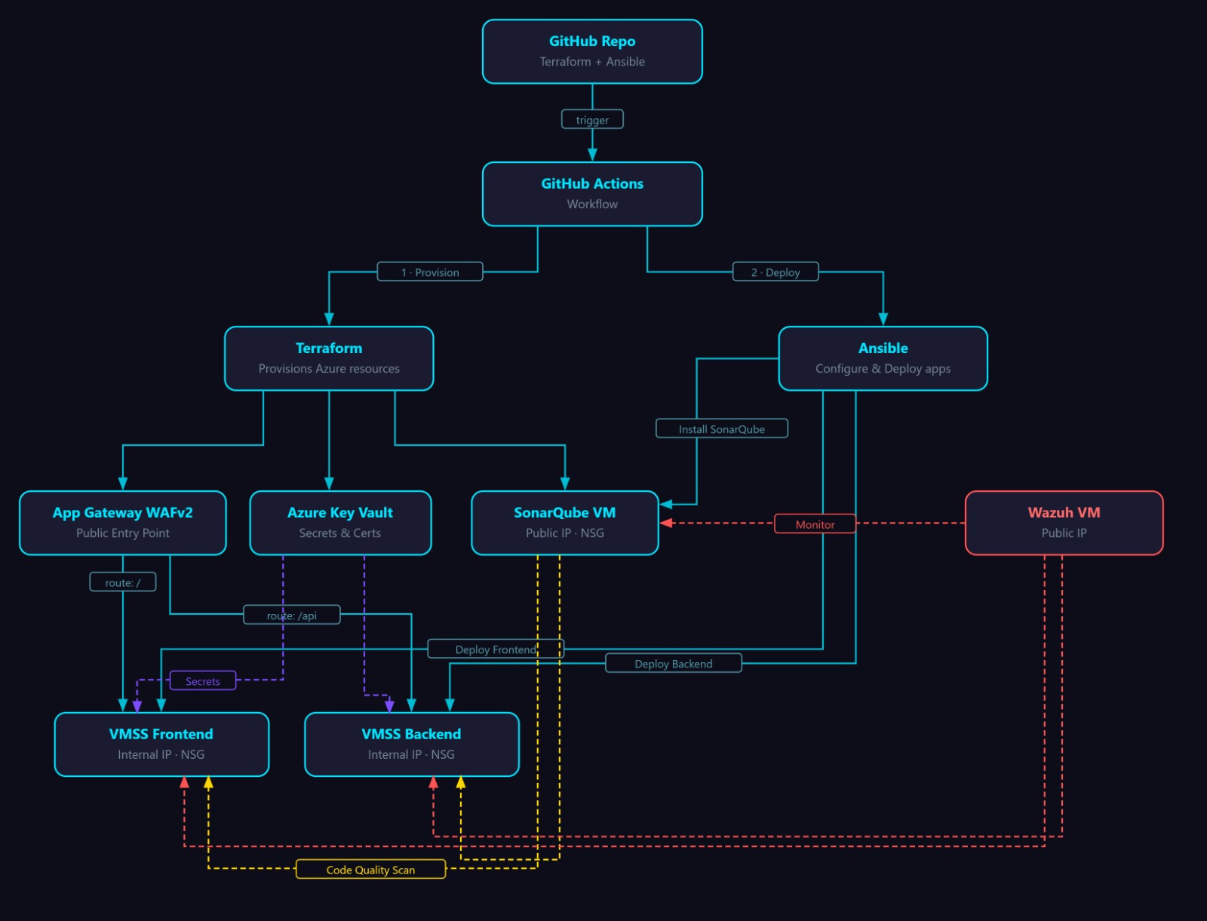

Slide 12

Burger Builder
SECURITY ARCHITECTURE
OVERVIEW
WAF INTEGRATED APP GW
CREDENTIAL SECURITY
Azure App Gateway WAF v2 with OWASP protection rules and SSL/TLS encryption via Certbot.
All the credentials stored in Azure key vault which makes them more secure and manageable
WAZUH SIEM
ENCRYPTED TRAFFIC
Wazuh SIEM for intrusion detection, log analysis, and real-time threat alerting.
SSL/TLS encryption implemented via Certbot.

Slide 13

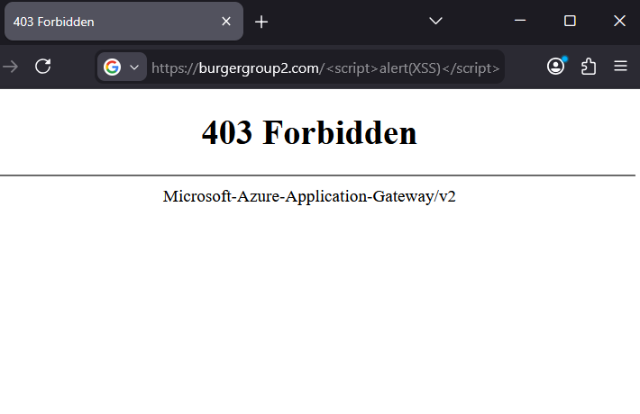
Burger Builder
Home
Security
SIEM
20 / 25
WAF V2
SECURE APPGW
Powerful Web Application Firewall (WAF) that blocks web attacks, monitors traffic, and instantly alerts on threats. PCI-DSS & GDPR compliant for secure and resilient applications.

Slide 14
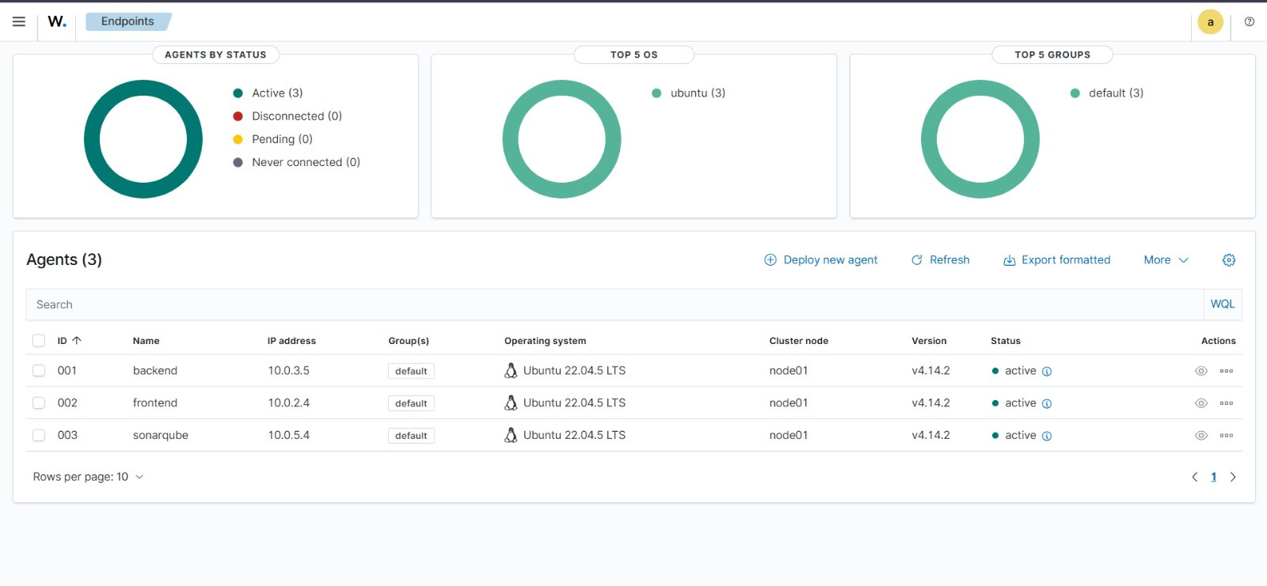
Burger Builder
Home
Security
SIEM
20 / 25
WAZUH SIEM(OUR NEW FEATURE)
THREAT DETECTION
Enterprise-grade security monitoring with real-time intrusion detection, log analysis & correlation, file integrity monitoring, and vulnerability scanning. Compliance-ready for PCI-DSS & GDPR with instant alerting on failed logins, suspicious API calls, and malware detection.

Slide 15
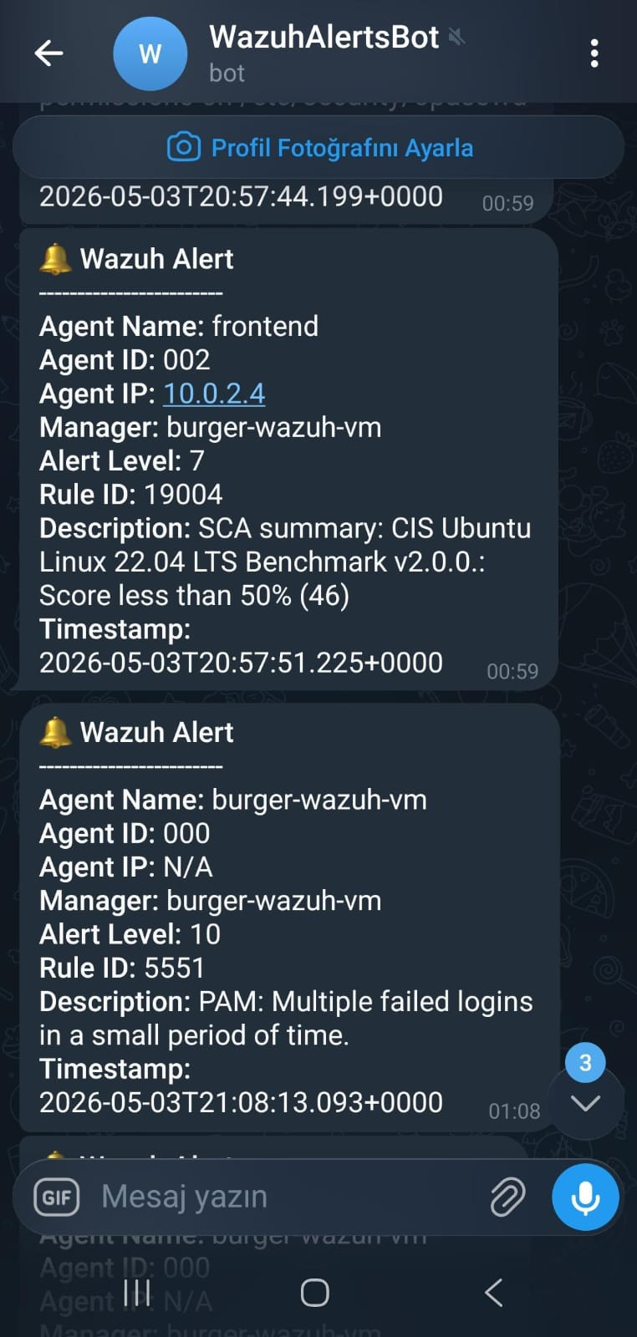
Burger Builder
Home
Security
SIEM
20 / 25
WAZUH SIEM
TELEGRAM INTEGRATION
SIEM-powered Telegram integration delivering real-time security alerts directly to your device. Monitor threats instantly with advanced log correlation, intrusion detection, file integrity monitoring, and vulnerability insights—no constant dashboard tracking required. Stay compliant and responsive with immediate notifications for suspicious activity, failed authentications, and critical system events.

Slide 16


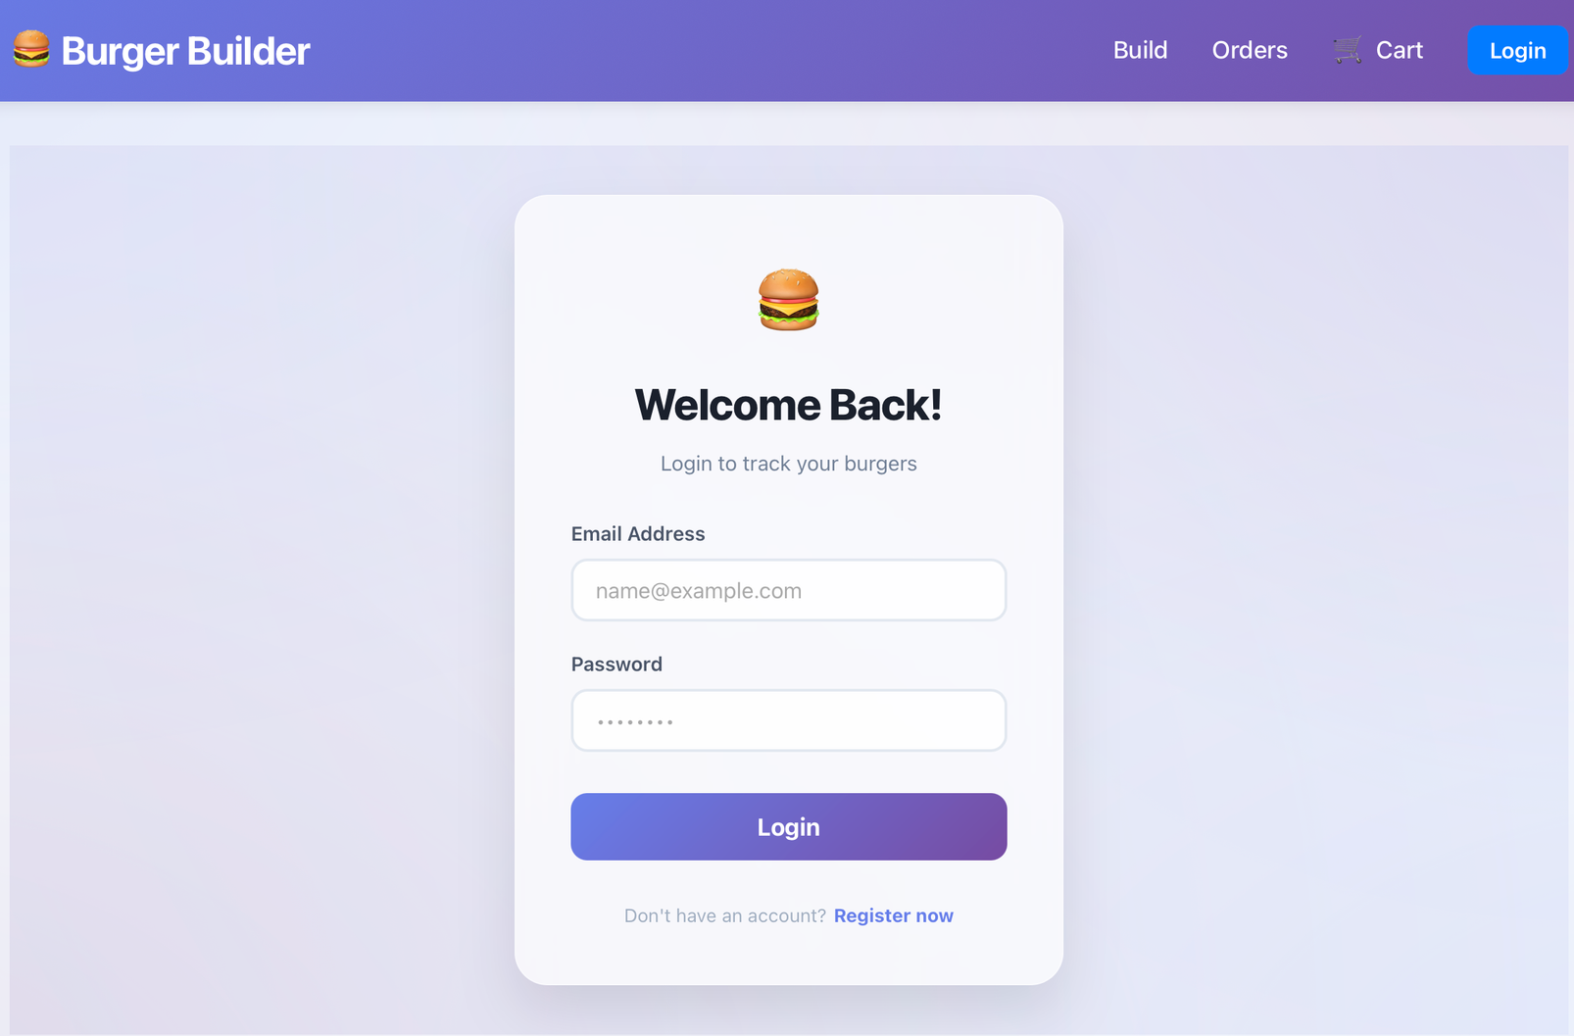
NEW FEATURE: USER AUTHENTICATION FLOW
We have implemented a complete Registration and Login system to make the ordering process secure and personalized.
How it works:
Before placing any order, the user must register an account
After registration, the user needs to log in (authorize)
Only authenticated users can access the cart, build custom burgers, and place orders

Slide 17
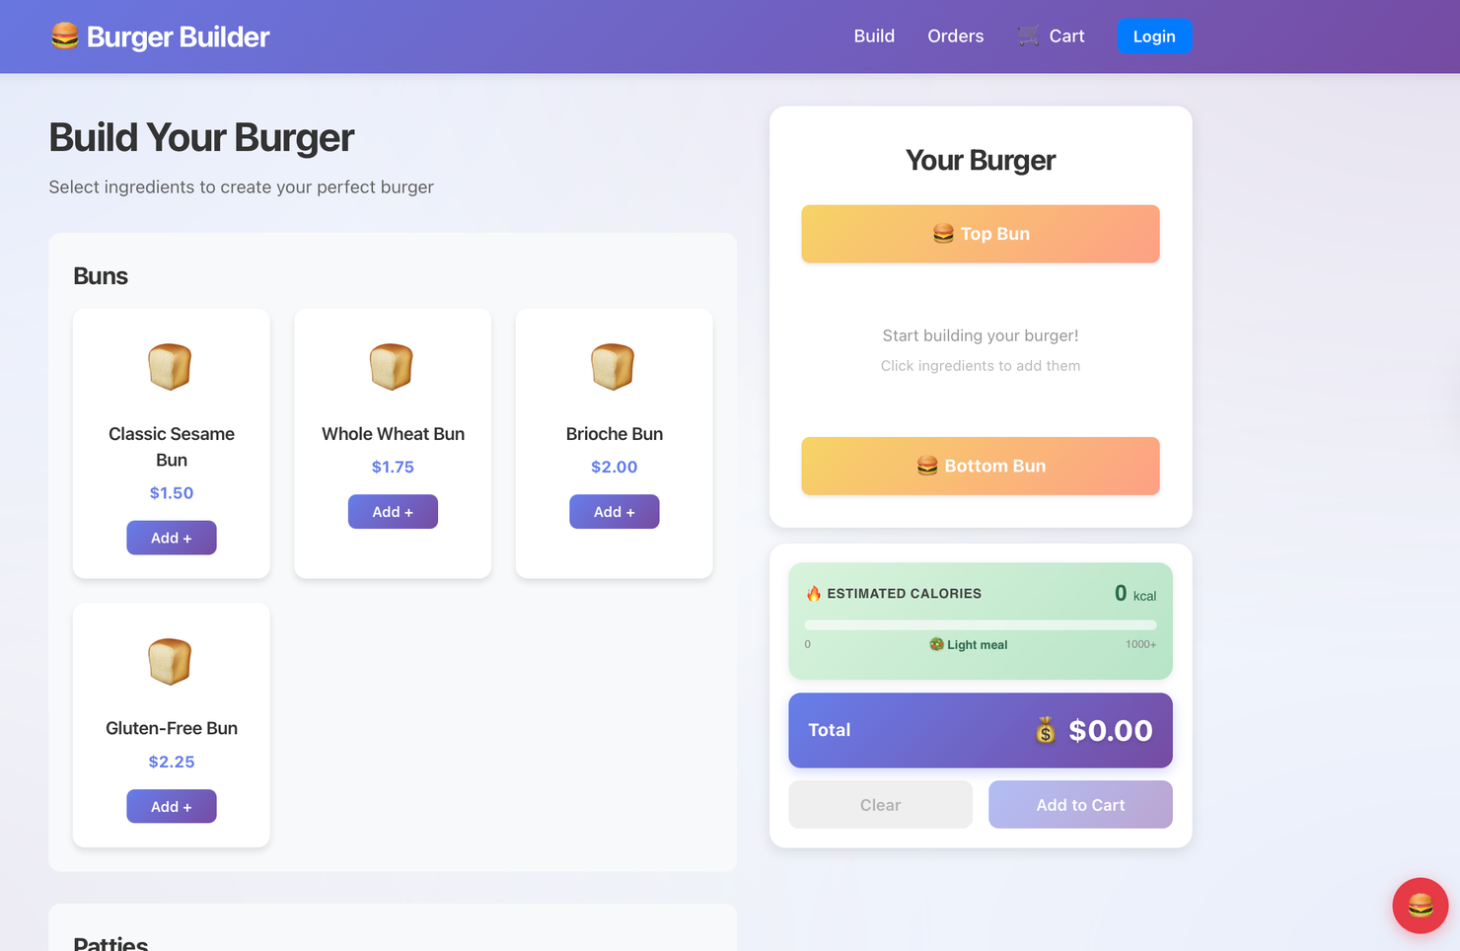
Burger Builder
NEW FEATURE:
ESTIMATED CALORIES
We added a real-time calorie calculator directly into the burger builder.
How it works:
As the customer adds or removes ingredients, the system instantly calculates the total calories of the burger.
A visual bar shows whether the burger is a Light meal or a high-calorie one.
The customer can clearly see the estimated calories before adding the burger to the cart.

Slide 18
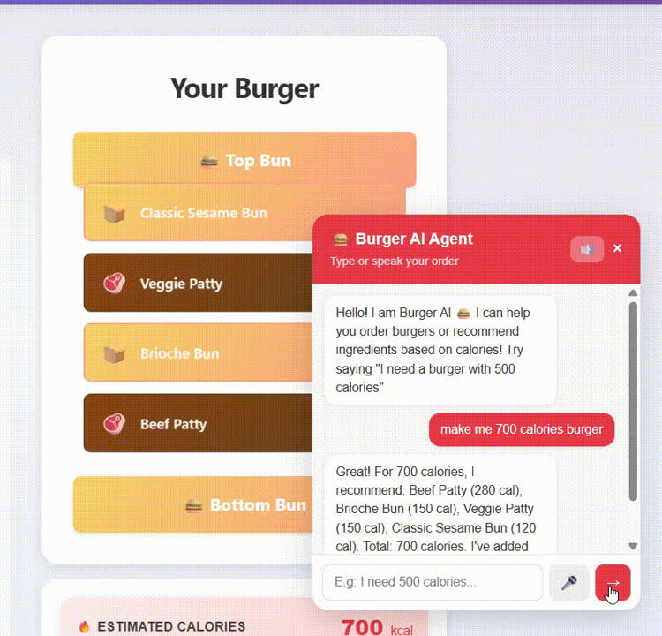
NEW FEATURE
BURGER AI AGENT
🎤 Conversational Ordering
Talk naturally to the AI to build your burger step-by-step. Switch effortlessly between voice and text input modes with instant low-latency responses.
🤖 Smart Recommendations
Powered by Azure OpenAI GPT-4o-mini for intelligent burger recommendations tailored to your taste preferences and dietary needs.
🔊 Real-Time Voice
Azure Speech SDK enables real-time voice input and output for seamless hands-free interaction with smooth, natural conversation flow.

Slide 19


Hudson Hornets 🐝
100% IaC
3 Pipelines
<2s API
99.9% Up
THANK YOU!
Q&A
✅ 100% Infrastructure as Code • ✅ 3 Automated CI/CD Pipelines
✅ <2 Second API Response • ✅ 99.9% Uptime • ✅ Zero Security Incidents
https://burgergroup2.com
Q&A
Questions? Let's Connect!

